Slide 1
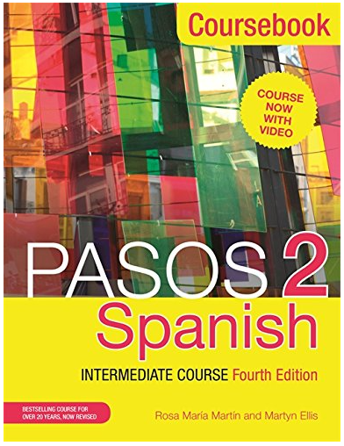
Spanish lesson
about
JOB INTERVIEWS
Unit 2 Section C
Buy the Pasos 2 coursebook
Ctrl + click to follow the link

Slide 2
Past tense verbs
Invited
Got up
Called
Said
Went
Had
Said sorry
Didn’t answer
Went
Looked for
Wrote
Did damage
Bought
Saw
Gave
Buscó
Dijo
Llamó
Invitó
Se fue
Pidió perdón
Fue
Compró
Tomó
Hicieron daño
Vio
Escribió
No contestó
Dio
Se levantó

Slide 3
Direct object pronouns.
Me te lo la nos os los las
Sherry hit Bill.
Who did Sherry hit?
Sherry hit him.
Ella me ama.
Te conozco.
Ella lo ama.
Juan la ve.
Ellos nos llaman.
Ellos os llaman.
Los llamamos.
Las veo.

Slide 4
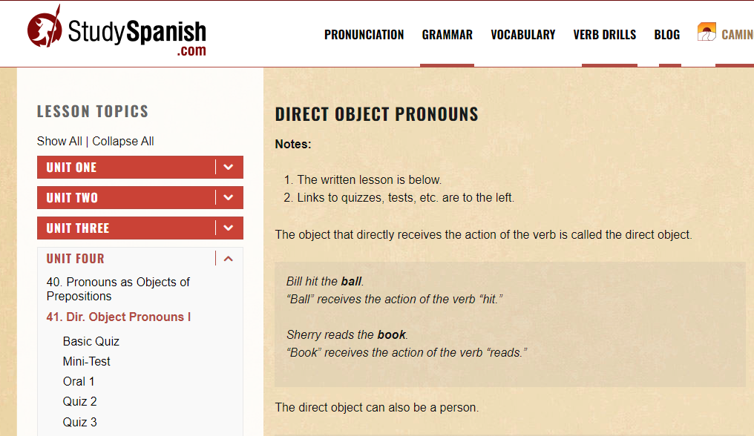
Direct object pronouns at studyspanish.com: https://studyspanish.com/grammar/lessons/dopro1
Ctrl + click to follow this link

Slide 5
Indirect object pronouns.
Me te le nos os los les
He gave the book to María.
He buys me wine.
My mum writes to me every week.
Juan le compra un regalo.
Juan les compra un regalo.
Ella le escribe una carta.
Ella les escribe una carta.

Slide 6
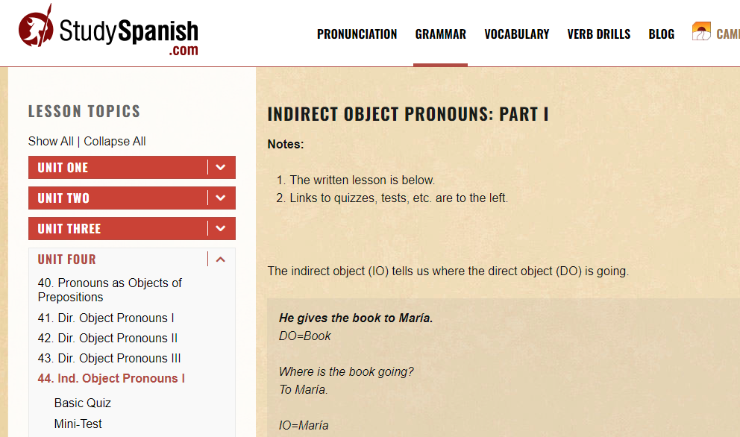
Indirect object pronouns: https://studyspanish.com/grammar/lessons/iopro1
Ctrl + click to follow this link

Slide 7
Personal pronouns
She called him
She invited him to the cinema
She said to him, “ I will wait for you in the bar.”
She bought a book for him
She waited for him
She looked for him
She didn’t see him
She wrote a card to him
She told him she was very angry
She didn’t give the book to him
She gave the card to him
Luis called her
Lolita didn’t answer him

Slide 8
Personal pronouns
She called him. D.O.
She invited him to the cinema. D.O.
She said to him, “ I will wait for you in the bar.” I.O.
She bought a book for him. I.O.
She waited for him. D.O.
She looked for him. D.O.
She didn’t see him. D.O.
She wrote a card to him. I.O.
She told him she was very angry. I.O.
She didn’t give the book to him. I.O.
She gave the card to him. I.O.
Luis called her. D.O.
Lolita didn’t answer him. I.O.

Slide 9
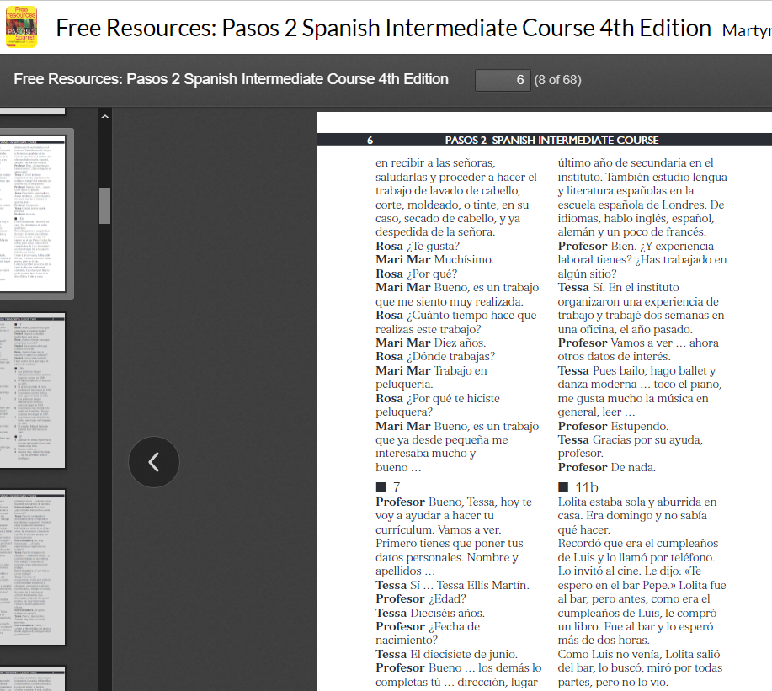
Pasos transcripts are free! Download them here: https://library.jmlanguages.com/viewer/?id=004325727
Ctrl + click to follow the link

Slide 10
Vocab
Me siento muy enfadada
Sé que es tu cumpleaños
dejar me plantada así
Así que fui al bar
¿Qué te pasó?
lo voy a disfrutar
un reloj
I am going to enjoy it
Standing me up like that
I feel very angry
What happened to you
So I went to the bar
A watch
I know it is your birthday

Slide 11
Una carta
Hola Luis,
Me siento muy enfadada. Sé que es tu cumpleaños, pero no está bien dejar me plantada así. Te invité al cine, y tú me dijiste: “Sí, nos vemos en el bar.” Así que fui al bar (con un regalo que no te voy a dar) y te esperé durante DOS HORAS. ¿Qué te pasó? Te busqué, por todas partes, pero claro, no te encontré. ¿Sabes qué, Luis? Fuiste tú quién dijó “a las siete.”
Te compré un libro. Se llama, Cómo ganar amigos e influenciar personas. Yo lo voy a leer, y lo voy a disfrutar. Creo que tú deberías comprarte un reloj.
Lolita.

Slide 12
Nada soy, Eva Ayllón
I looked for you, everywhere, I looked for you
“Te busqué, por todas partes, te busqué”
I am nothing
Nada soy
Without your love, I am nothing
Sin tu cariño, nada soy
I am nothing
Nada soy
If I don't have you, I am nothing
Si no te tengo, nada soy
You taught me to love you with delirium
Me enseñaste a quererte con delirio
Today my life is a martyrdom if you are no longer with me
Hoy mi vida es un martirio si no estás más junto a mí
I looked for you, everywhere, I looked for you
Te busqué, por todas partes, te busqué
And not being able to find you, I cried for you
Y al no poder encontrarte, te lloré
What pain I feel in my chest
Qué dolor siento en mi pecho
Ouch how painful
Ay, qué dolor
you forgot about your love
Te olvidaste de tu amor
That today he will not live without you
Que hoy no vivirá sin ti
You left, for no reason, from my side
Te fuiste, sin motivo, de mi lado
cried my sacrificed heart
Lloró mi corazón sacrificado
The being that loved you passionately
El ser que a ti te quiso con pasión
And who gave you his love
Y que te dio su amor
It does not have the sweetness of your kisses
No tiene la dulzura de tus besos
Nor the tenderness of your love
Tampoco la ternura de tu amor
Now I am nothing, without your love, I am nothing
Ahora nada soy, sin tu cariño, nada soy
Listen to the beautiful song, and enjoy the past tense verbs too!
https://www.youtube.com/watch?v=kv0I1flxnRg
Ctrl + click to follow link

