Slide 1
Pedro Rabbit
Based on Peter Rabbit
by Beatrix Potter
Spanglish versión creado por
Lucía Corazón

Slide 2
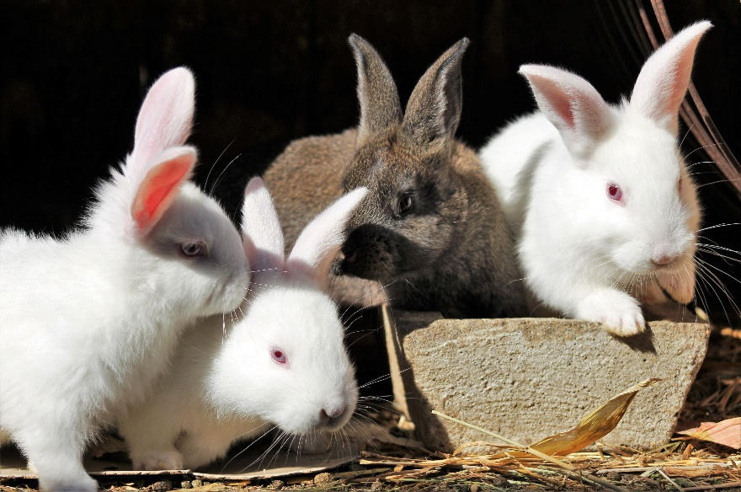
Pedro Rabbit
Once upon a time there were uno, dos, tres, cuatro little rabbits, and their nombres were Flopsy, Mopsy, Cotton-tail, and Pedro.

Slide 4
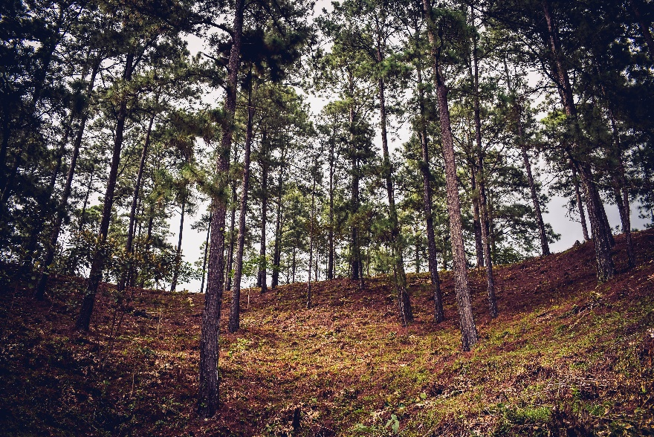
They lived with their Mamá in a sand-bank, underneath the roots de un muy grande fir-tree.

Slide 6
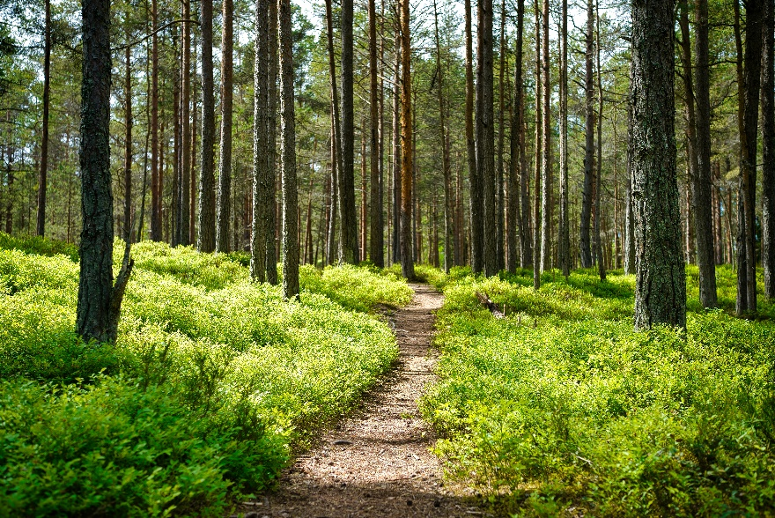
“Now, mis amores,” said old Señora Rabbit una mañana, “you may go into the fields or down la avenida.”

Slide 8
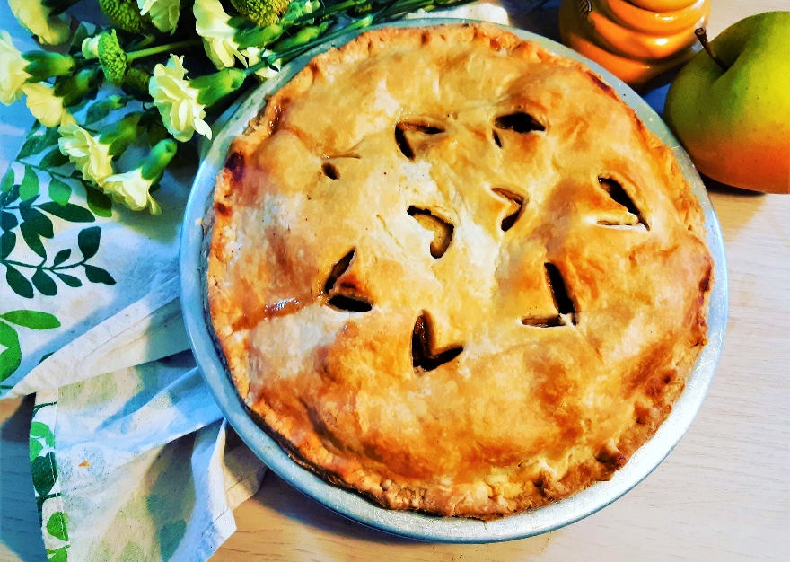
“But don’t go into el jardín of old Señor McGregor: your Papá had un accidente there. He was put in a pie by Señora McGregor.”

Slide 10
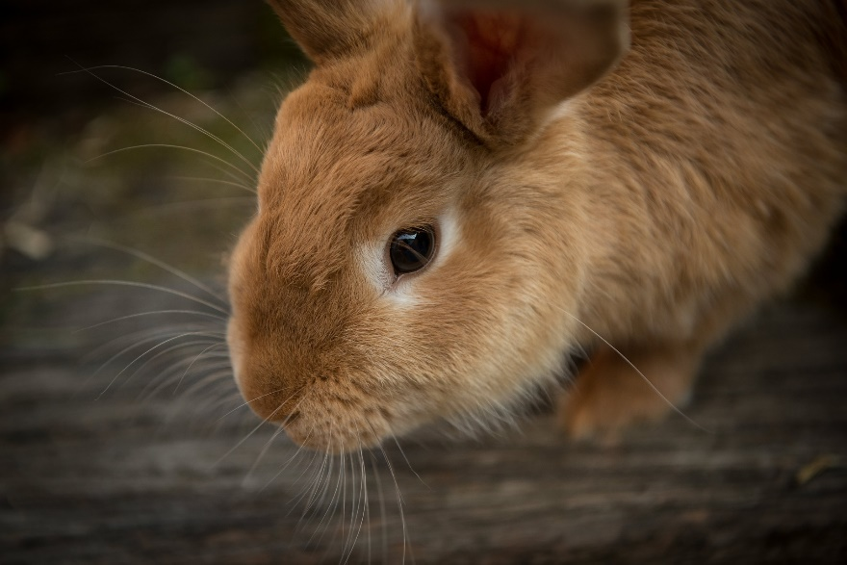
“Now run along. ¡Vamos! And don’t get into any mischief. I am going out.”

Slide 12
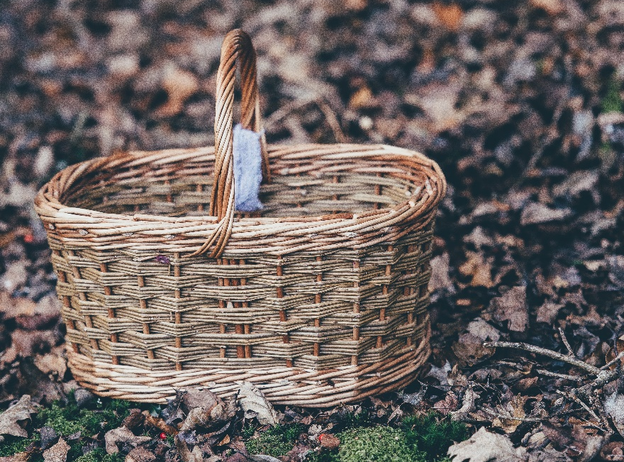
Then old Señora Rabbit took a basket and her paraguas, and went through el bosque to the baker’s.

Slide 14
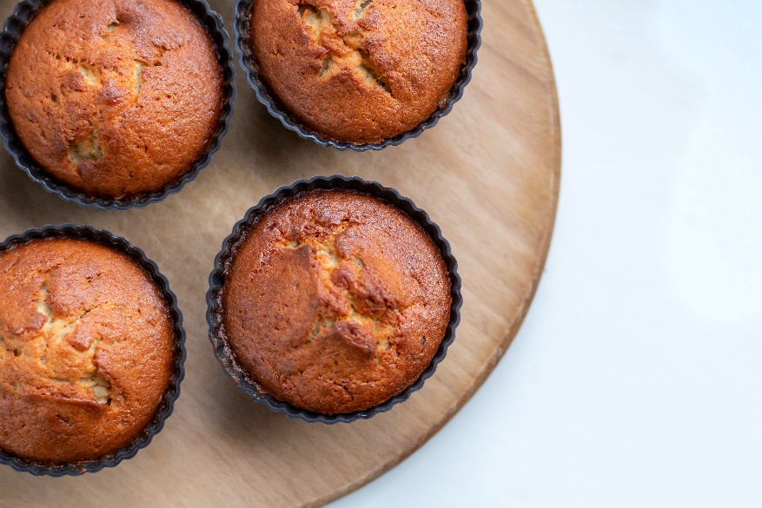
She bought una botella de limonada and uno, dos, tres, cuatro, little cakes called Magdalenas.

Slide 16
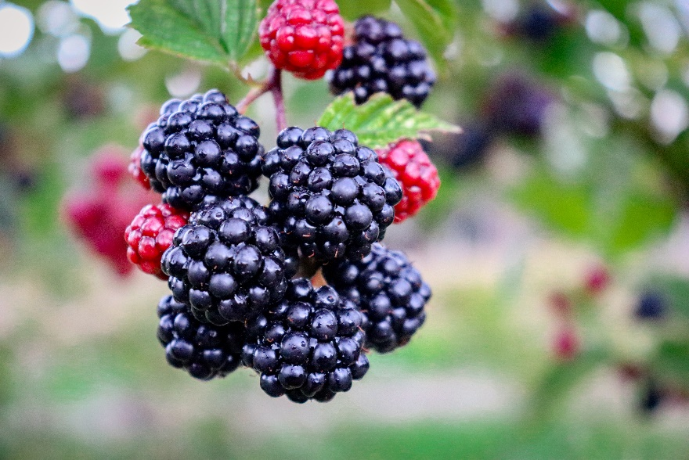
Flopsy, Mopsy, and Cotton-tail, who were good little bunnies, went down la avenida to gather blackberries.

Slide 18
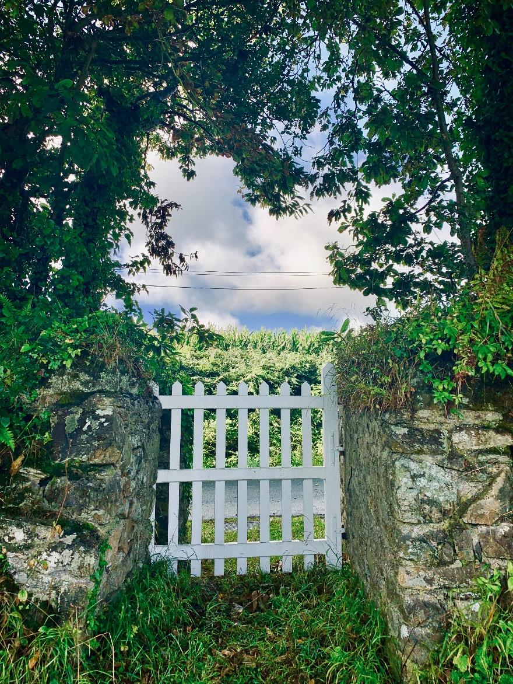
But Pedro, who was muy travieso, ran inmediatemente to el jardín de Señor McGregor, and squeezed under the gate!

Slide 20
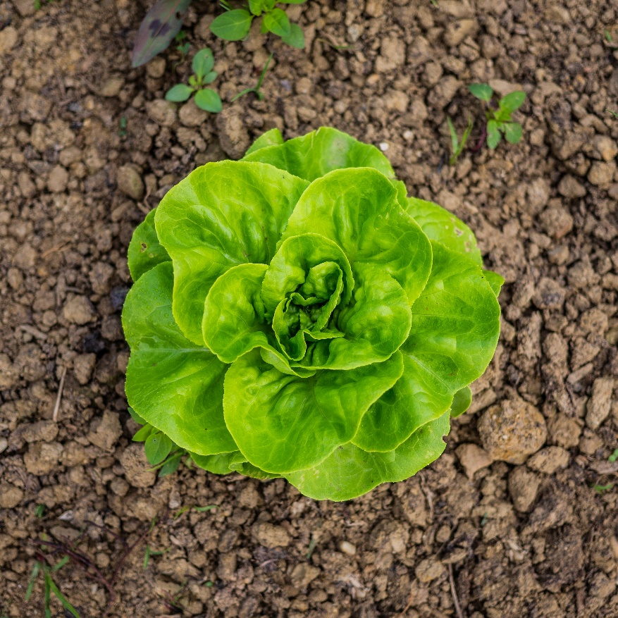
Primero he ate some lechugas and some coliflor; and then he ate some tomates.

Slide 22
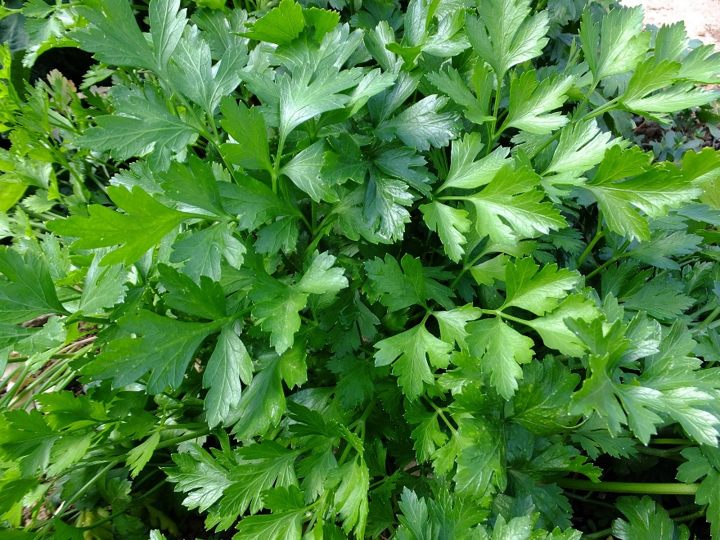
And then, feeling un poco sick, he went to look for some parsley.

Slide 24
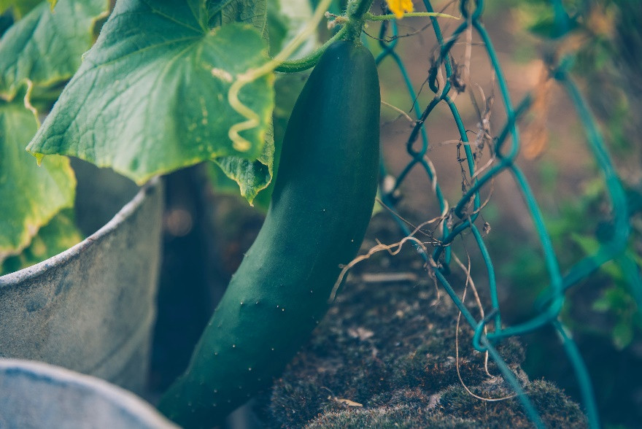
But round the end of the pepino frame, who should he encontrar but Señor McGregor!

Slide 25
Señor McGregor was on his manos y rodillas planting out some young plantas de brócoli, but he jumped up and ran after Pedro, shouting out, “Stop, thief! ¡Ladrón!”

Slide 26
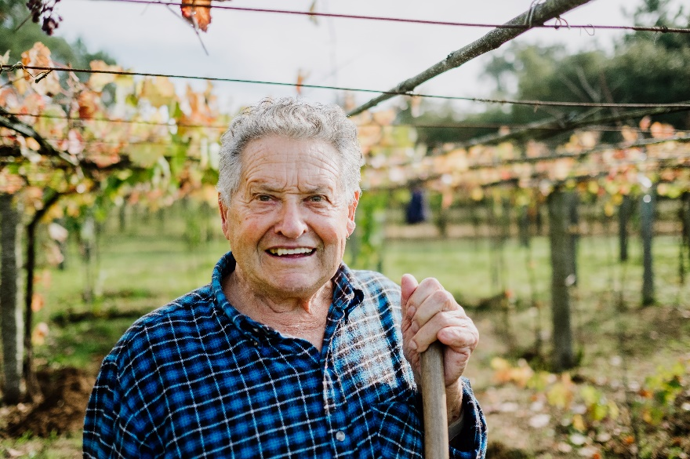

Slide 27
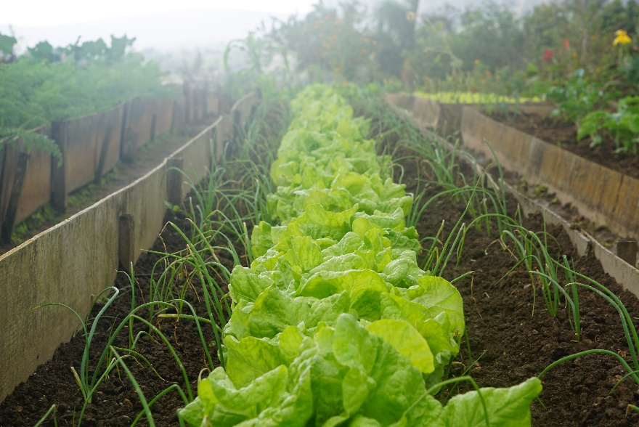
Pedro was muy, muy asustado; he rushed all over el jardín, porque he had forgotten the way back to the gate.

Slide 29
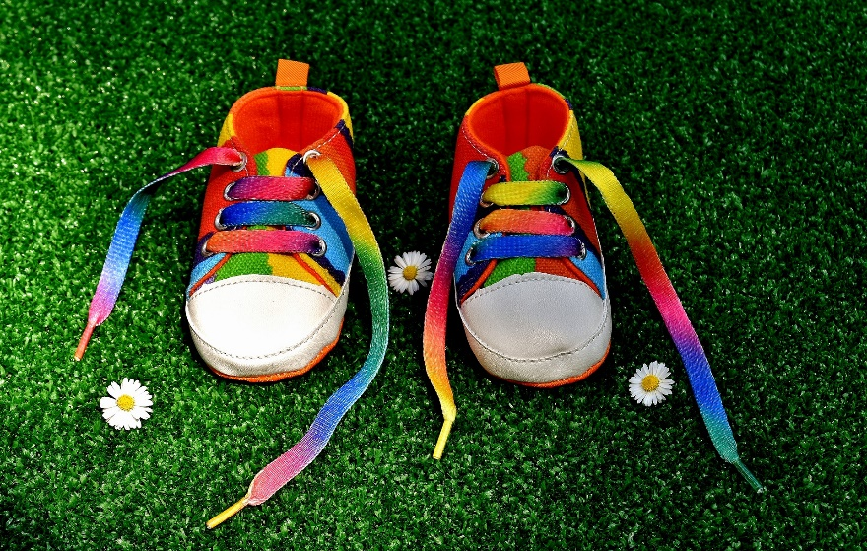
He lost one of his zapatos amongst el brócoli, and the other zapato amongst las patatas.

Slide 31
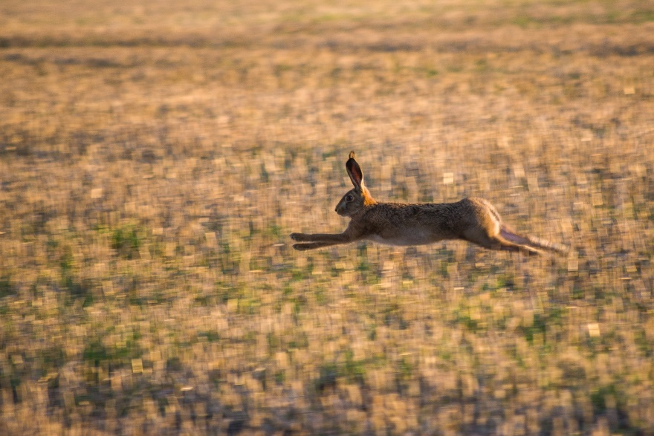
After losing his zapatos, he ran on cuatro patas and went mucho más rápido.

Slide 33
He might have escapado if he had not run into a strawberry net, and got caught by the large botones on his chaqueta. It was a blue chaqueta with brass botones, quite new.

Slide 34
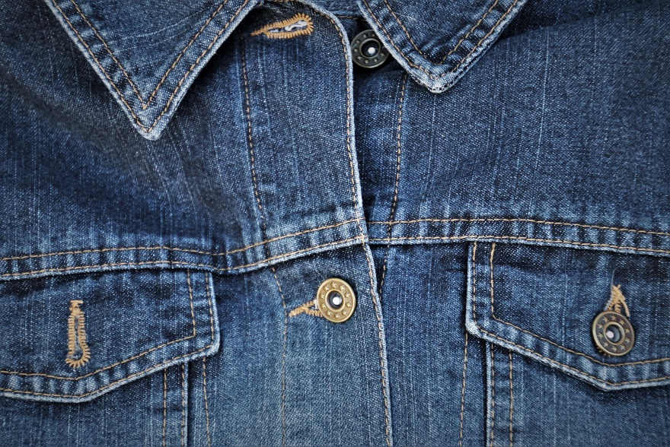

Slide 35
Pedro gave himself up for lost, and shed big tears; but his sobs were overheard by his amigos, the sparrows, who flew to him and begged him to try to escapar.

Slide 36
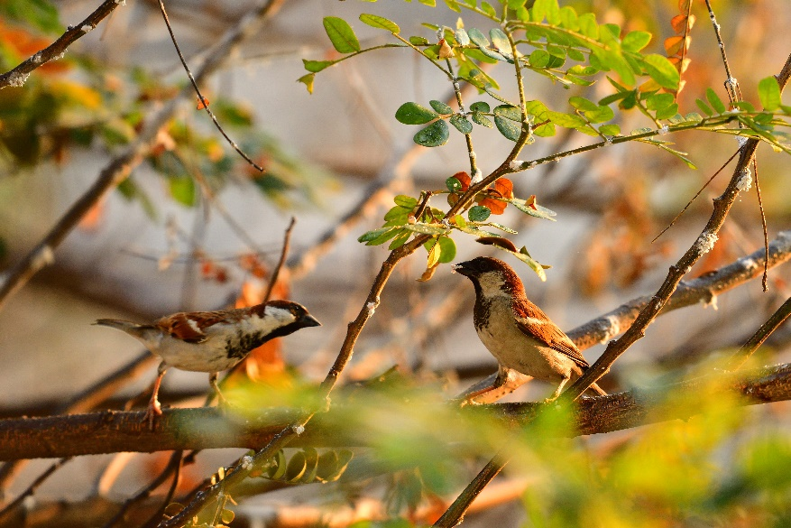

Slide 37
Señor McGregor came up with a bucket, with la intención to pop it over Pedro; but Pedro wriggled out of the strawberry net just in time, leaving his chaqueta behind him.

Slide 38
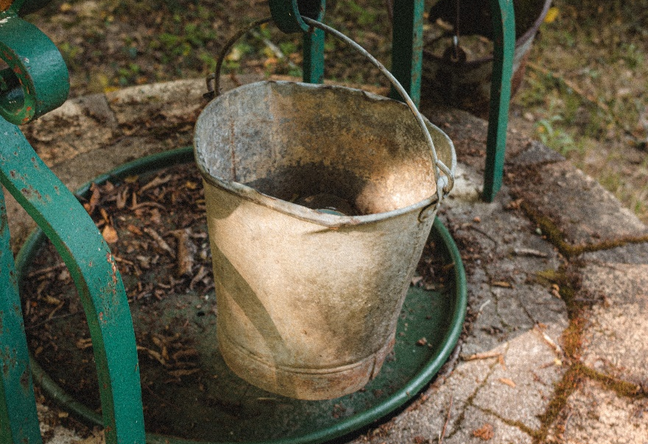

Slide 39
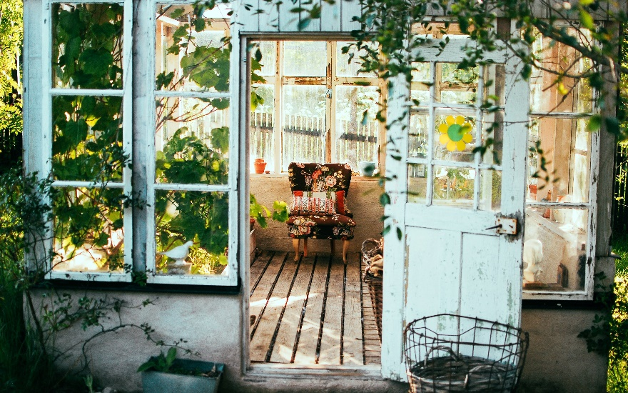
And rushed into the shed, and jumped into a watering-can. It would have been perfecto to hide in, if it had not been full of agua.

Slide 41
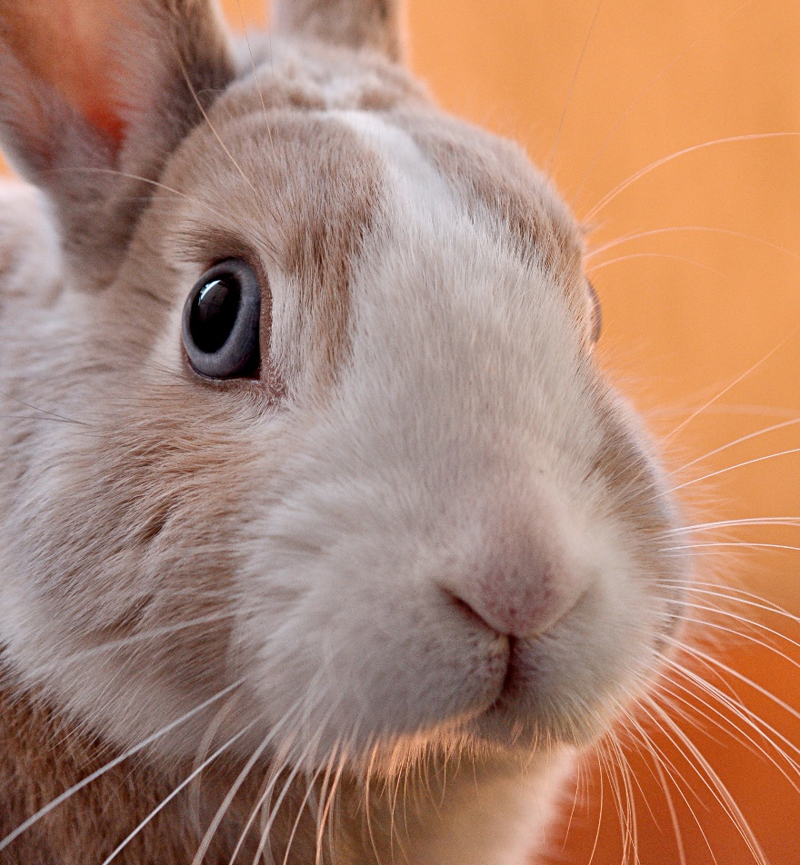
Señor McGregor was quite seguro that Pedro was somewhere in the shed, perhaps escondido underneath a flower-pot.

Slide 43
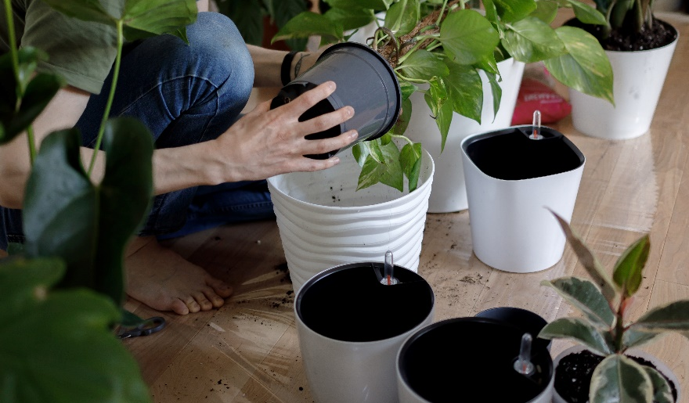
He began to turn over the pots, looking under cada uno. Pedro sneezed – “¡Achú!” Señor McGregor was after him inmediatemente.

Slide 45
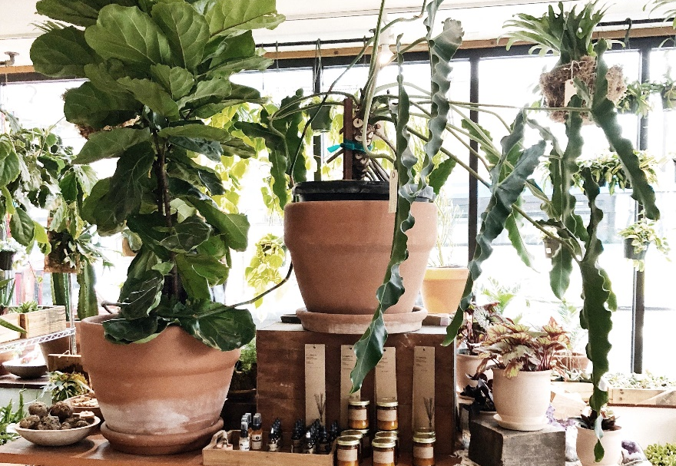
And tried to put his big, gardener’s bota on Pedro, who jumped out of a window, knocking over uno, dos, tres, cuatro plantas.

Slide 47
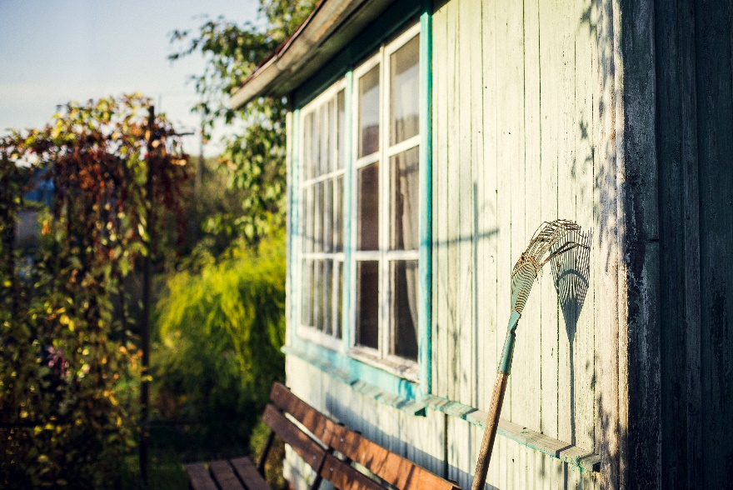
The window was too small for Señor McGregor, and he was tired of running after Pedro. He went back to his work en el jardín.

Slide 49
Pedro sat down to rest; he was out of breath and trembling porque he was so asustado, and he had no idea which way to go. Also, he was very damp from sitting in that watering can.

Slide 50
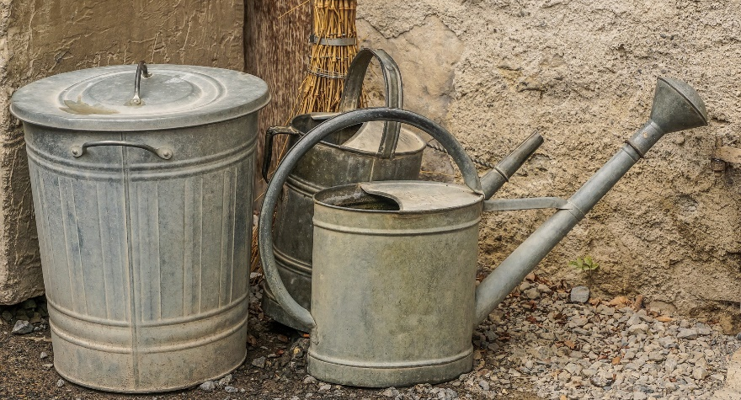

Slide 51
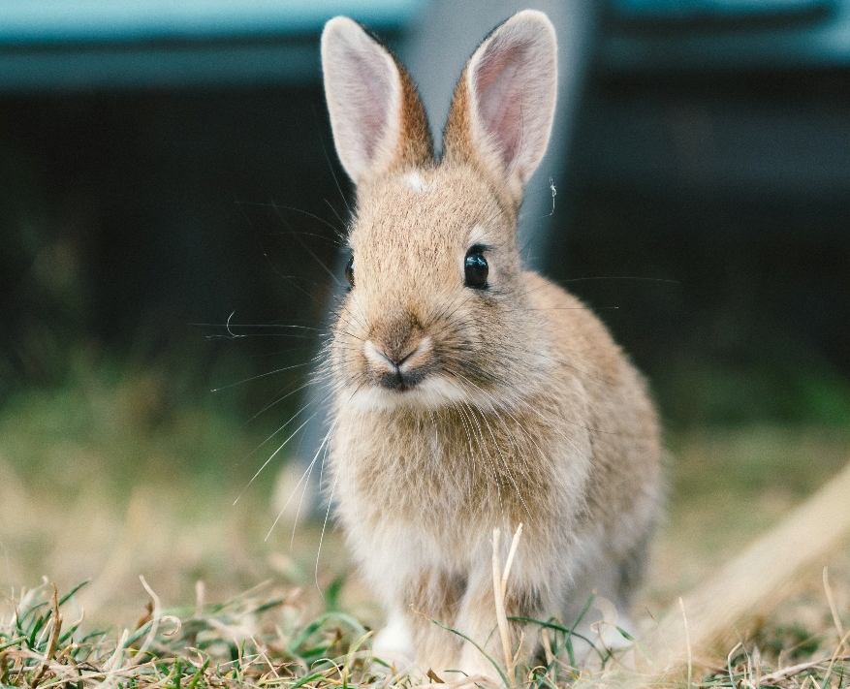
After un tiempo he began to wander about, going lippity- lippity – no muy rápido, looking all around.

Slide 53
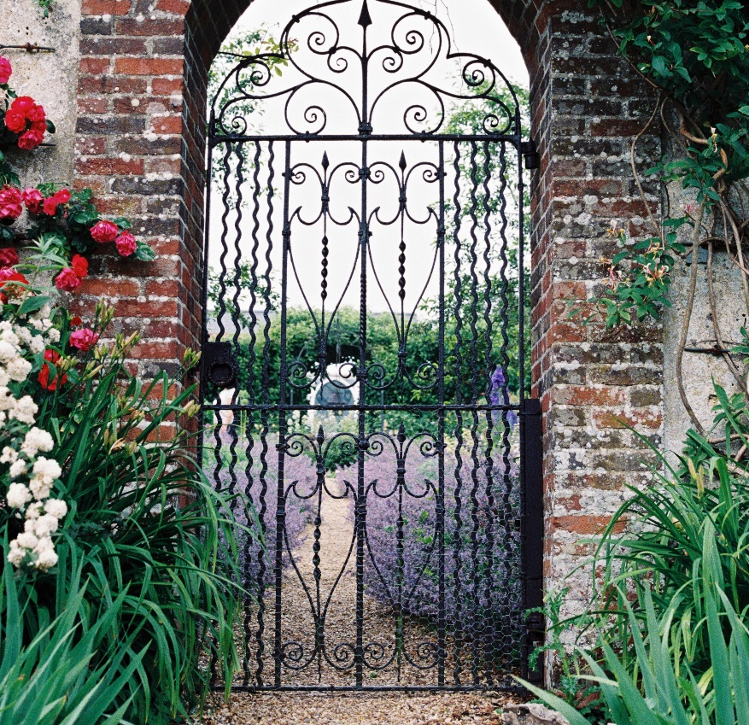
He found a door in una pared; but it was locked, and there was no espacio for a fat little rabbit to squeeze underneath.

Slide 55
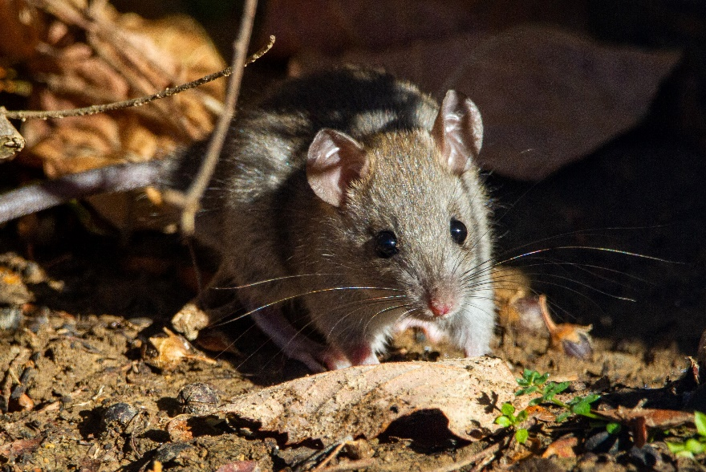
An old ratón was running in and out over the door-step, carrying peas and beans to her familia in the wood.

Slide 57
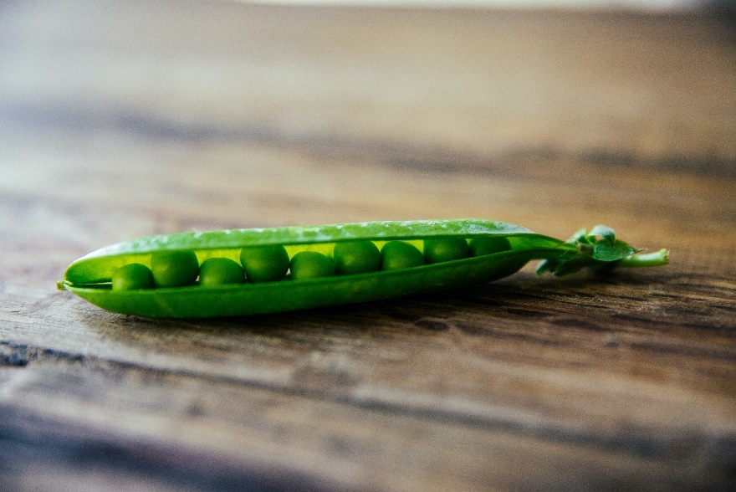
Pedro asked her the way to the gate, but the pea in her mouth was very grande and she couldn’t responder. She shook her cabeza at him. Pedro began to cry.

Slide 59
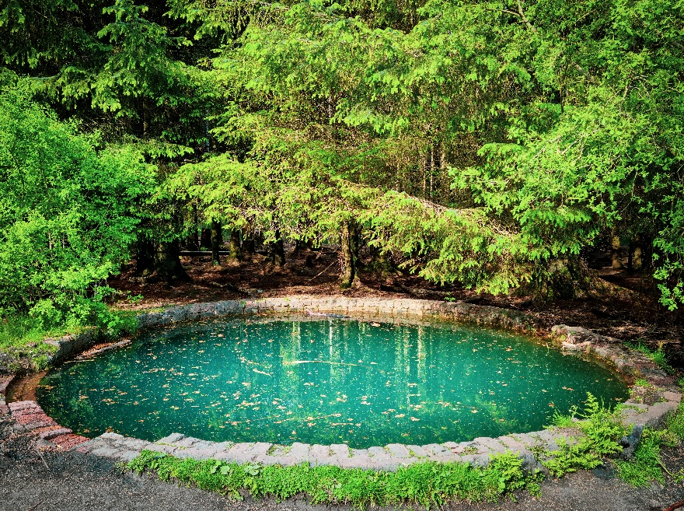
Then he tried to find his way straight across el jardín and came to a pond where Señor McGregor filled his watering cans.

Slide 61
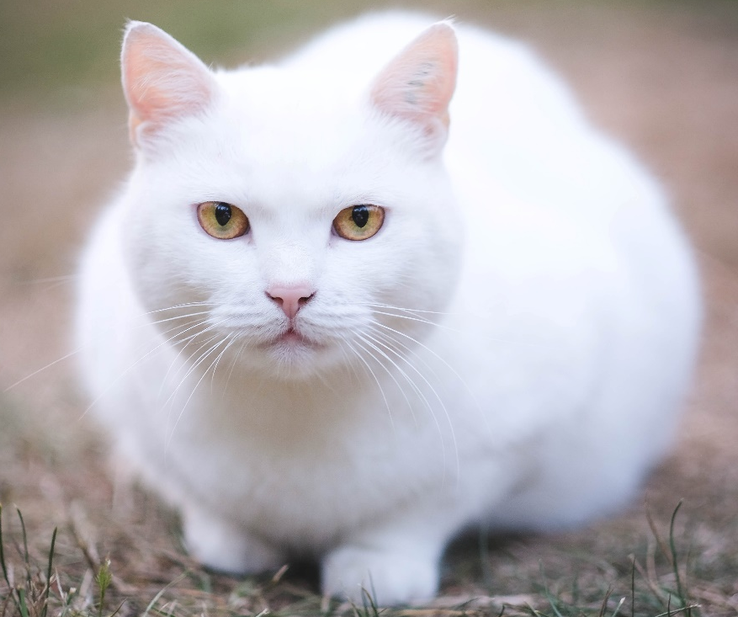
Un gato blanco was staring at some gold-fish. She sat very, very still, but now and then the tip of her cola twitched as if it was alive.

Slide 63
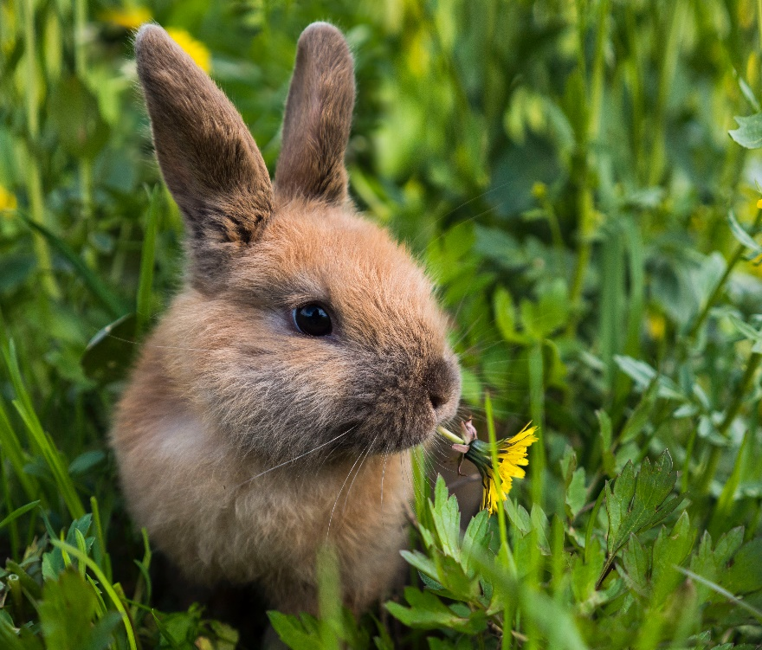
Pedro thought it best to go away without speaking to her; he had heard about gatos from his cousin, little Benjamin Bunny.

Slide 65
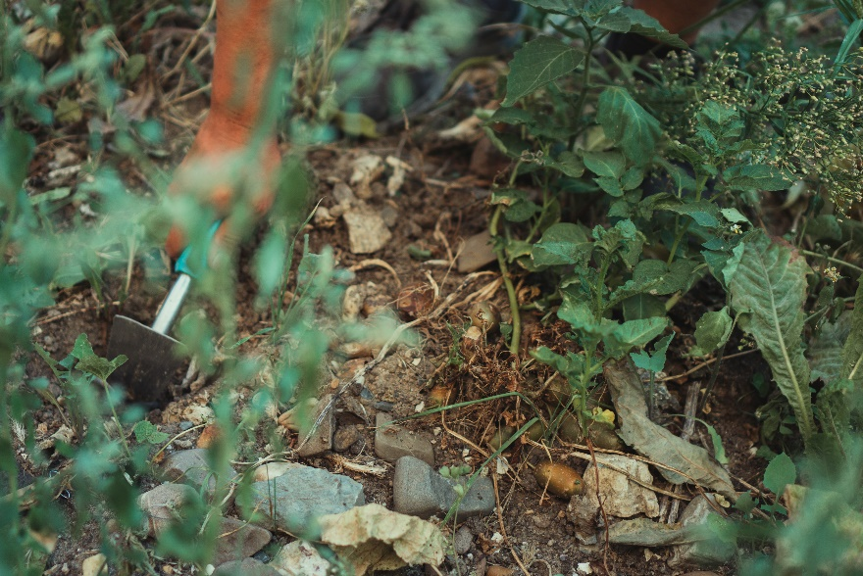
He went back towards the shed, but suddenly, quite close to him, he heard el sonido of a hoe – scr-r-ritch, scratch, scratch, scritch.

Slide 67
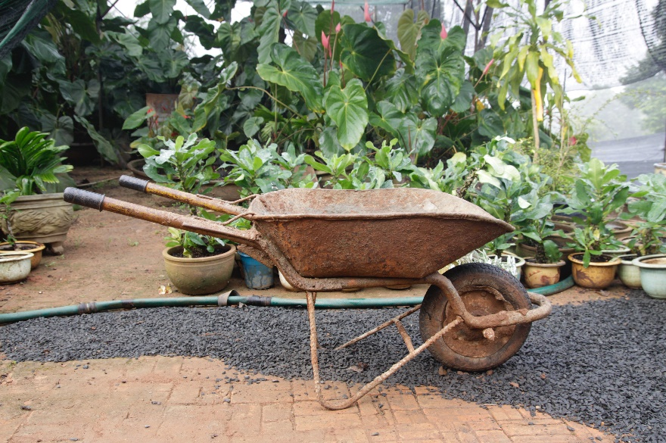
Pedro se escondió underneath the bushes. No pasó nada, so he came out and climbed on a wheelbarrow and peeped over.

Slide 69
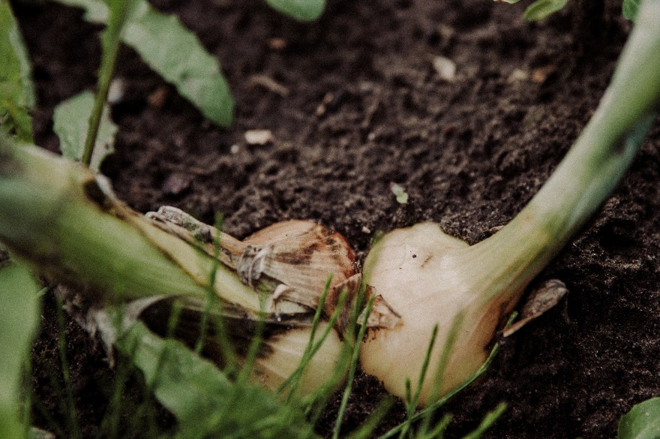
Señor McGregor was hoeing onions. His back was turned towards Pedro, and beyond him was the gate!

Slide 71
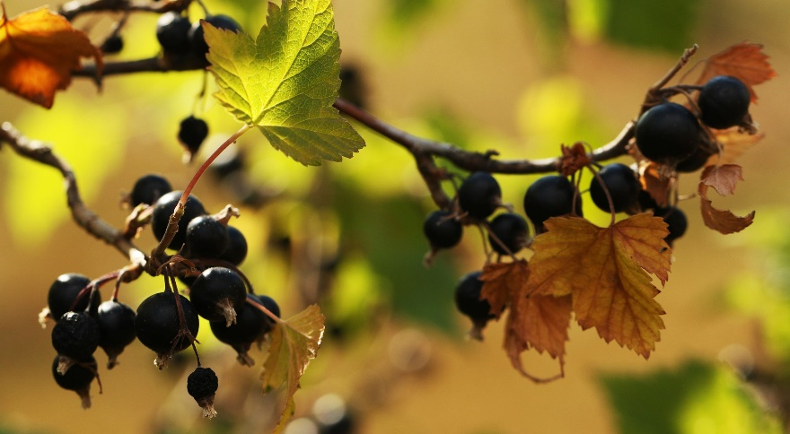
Pedro got off the wheelbarrow en silencio, and started running, muy rápido, along un sendero behind some black-currant bushes.

Slide 73
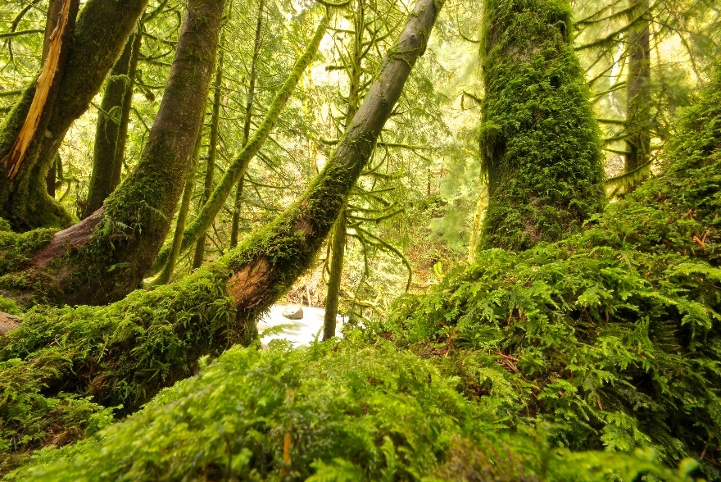
Señor McGregor caught sight of him at the corner, but Pedro slipped underneath the gate, and was safe, por fin, in the wood outside el jardín.

Slide 75
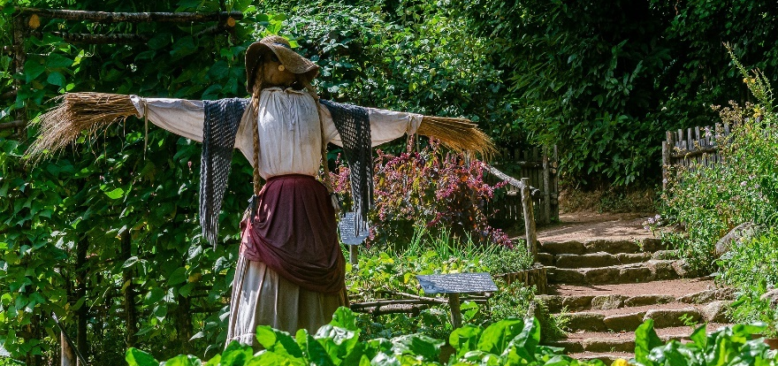
Señor McGregor hung up the little blue chaqueta and the zapatos for a scare-crow to frighten the blackbirds.

Slide 77
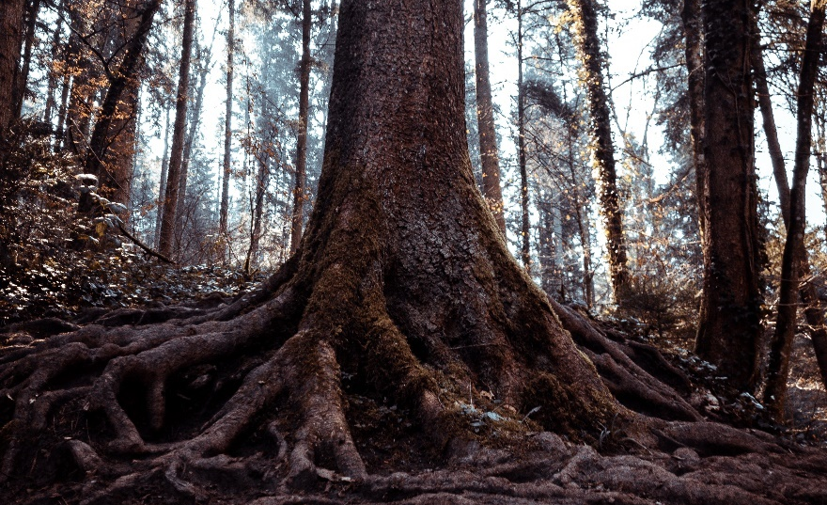
Pedro never stopped running or looked behind him until he got to his casa under the root of the grande fir-tree.

Slide 79
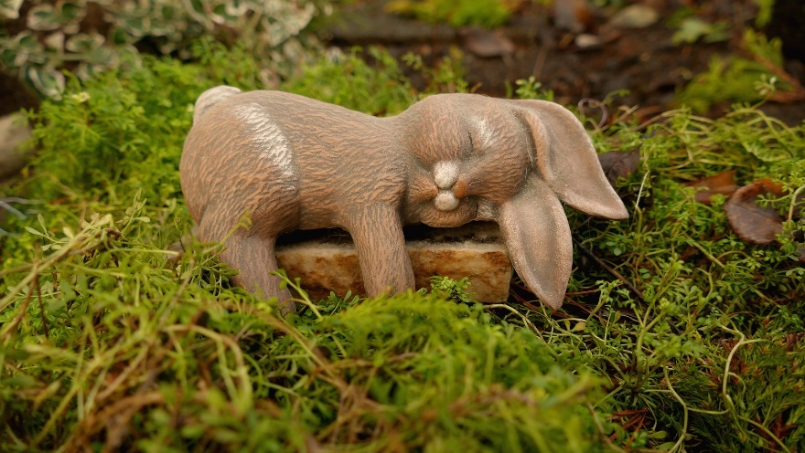
He was so tired that he flopped down on the nice soft sand of the rabbit-hole and shut his ojos.

Slide 81
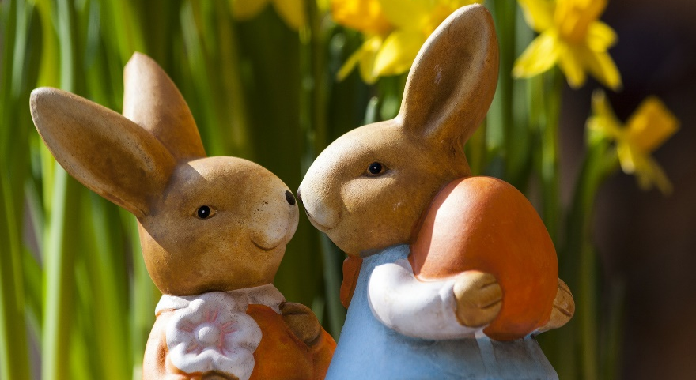
His Mamá was busy preparando the supper. She wondered what he had done with his little chaqueta and par de zapatos.

Slide 83
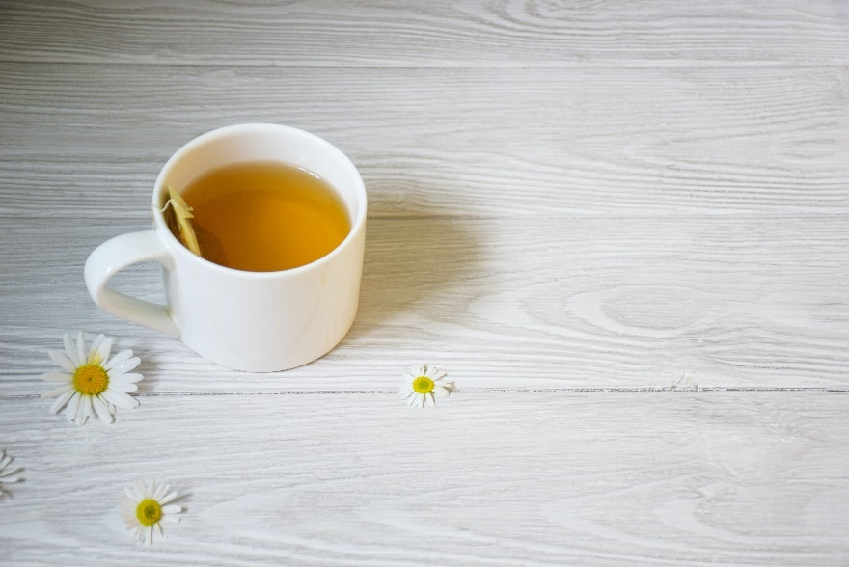
Pedro was not very well during the evening. His Mamá put him to bed, and made una infusión de camomile for him to sip.

Slide 85
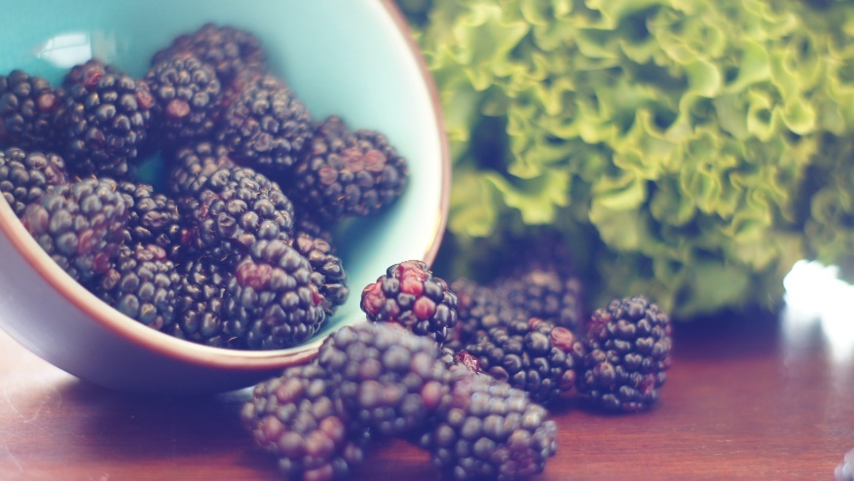
But Flopsy, Mopsy and Cotton-tail had moras deliciosas, and little cakes called Magdalenas, and a drink of limonada for their tea.

Slide 87
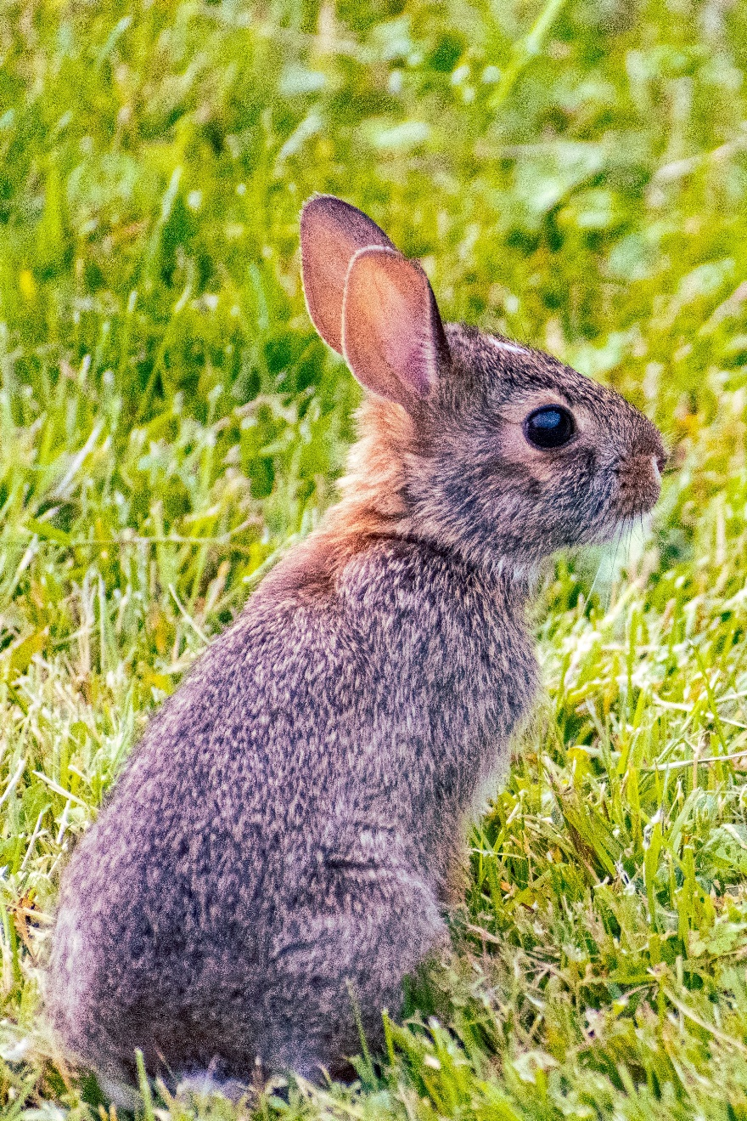
Pedro Rabbit

Slide 88
